Slide 1
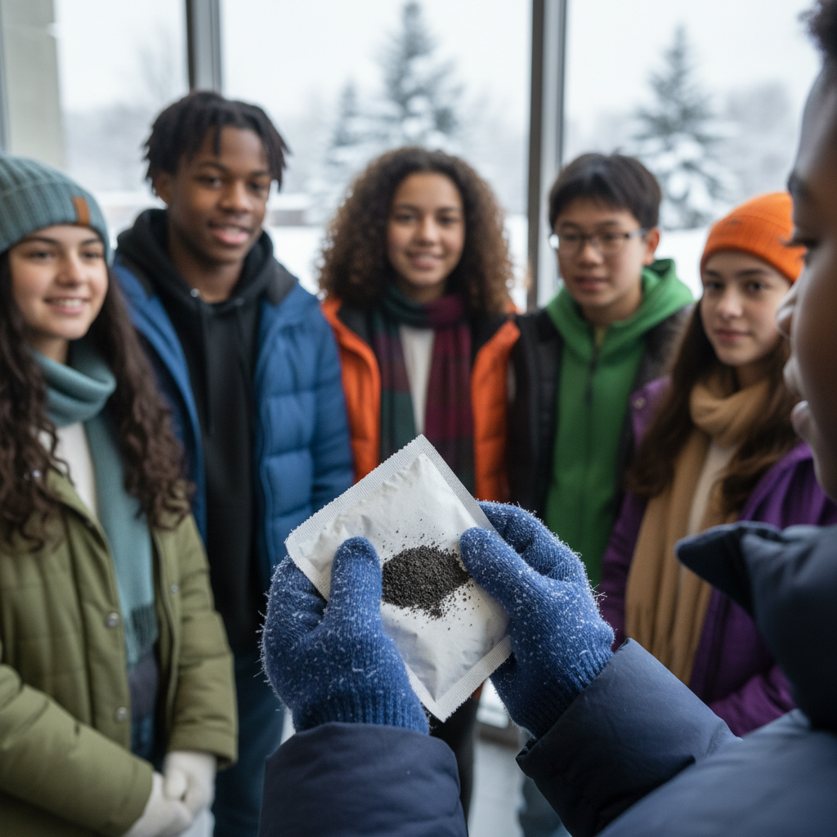
ModelIt!
Student Lesson
Hand Warmers and Hidden Reactions
How Atoms Rearrange to Create Heat, Light, and Everything You Use
NGSS: MS-PS1-4, MS-PS1-5
8th Grade
1/9

Slide 2
What You Will Learn Today
Learning Goals
* Explain how chemical reactions rearrange atoms to form new substances
* Model how exothermic reactions release energy as heat
* Apply the law of conservation of mass to chemical reactions
* Predict whether a reaction is exothermic or endothermic based on temperature change
Key Vocabulary
Chemical Reaction
A process where atoms rearrange to form new substances with different properties
Exothermic
A reaction that RELEASES energy as heat — the surroundings get warmer
Endothermic
A reaction that ABSORBS energy as heat — the surroundings get cooler
Conservation of Mass
In a chemical reaction, the total mass of reactants equals the total mass of products
2/9

Slide 3
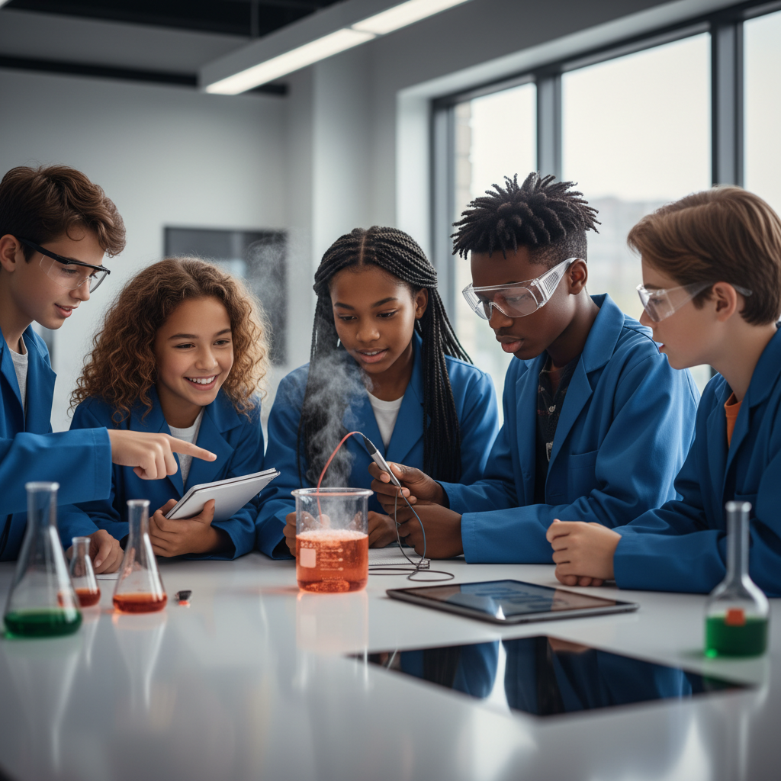
The Big Question
How can a small packet create heat without fire, batteries, or electricity?
How Atoms Rearrange to Create Heat, Light, and Everything You Use. Today we'll build a MODEL to discover the answer!
3/9

Slide 4

Today We Will Build a Model!
A model helps us understand complex systems!
1. LOCATE
Identify the COMPONENTS (parts) of the system
2. ESTABLISH
Connect them with RELATIONSHIPS (+ or -)
3. VISUALIZE
Build your model in ModelIt!
4. EVALUATE
Run SIMULATIONS to test scenarios
5. REVISE
Improve your model based on evidence
4/9

Slide 5
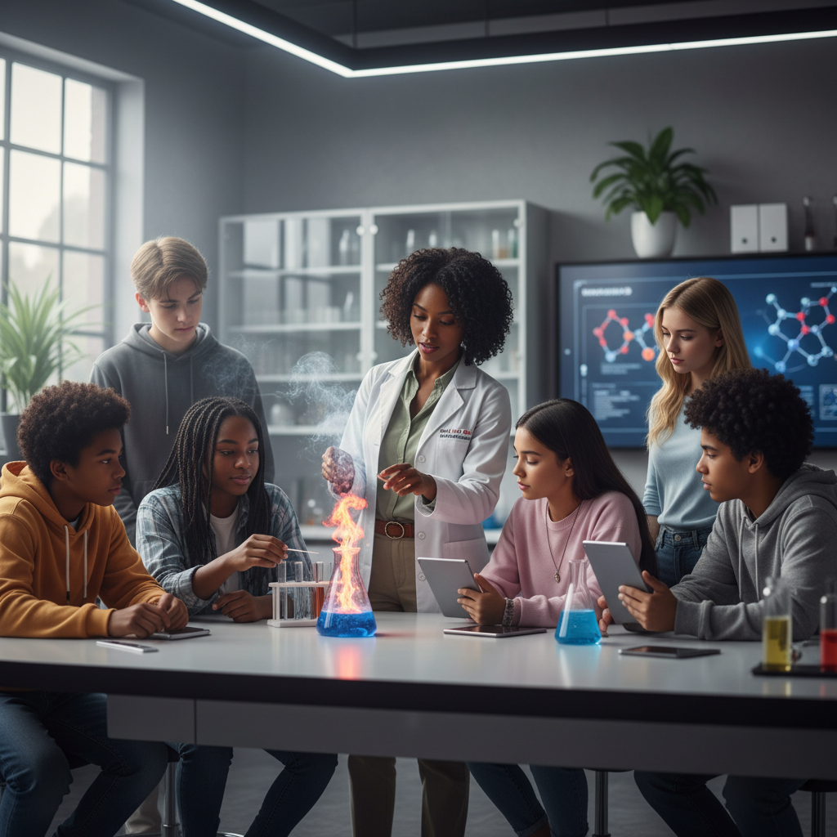
Activity 1: Sort the Components
Sort these components into EXTERNAL (inputs from outside) and INTERNAL (inside the system):
Your Components:
* Iron Powder Amount
* Oxygen Exposure
* Reaction Rate
* Heat Output
Think: Which components can we control? Which happen on their own?
5/9

Slide 6
Activity 2: Connect with Arrows
Draw arrows to show HOW components affect each other:
(+) POSITIVE Relationship
When one goes UP, the other goes UP too
(-) NEGATIVE Relationship
When one goes UP, the other goes DOWN
Think About It:
When you open a hand warmer and expose the iron powder to more oxygen, what do you think happens to the temperature?
6/9

Slide 7
Activity 3: Run the Simulation!
Test these scenarios in ModelIt!
Sealed Packet
Set Oxygen Exposure to 0% — the reaction can't start
Normal Use
Set Iron Powder to normal and Oxygen Exposure to moderate
Maximum Heat
Lock both Iron Powder and Oxygen Exposure to maximum
Watch the activity graphs change!
[ModelIt Platform Screenshot - Simulation Results Graph]
7/9

Slide 8
What Did We Discover?
Our Model Showed Us:
* Iron + Oxygen → Iron Oxide (rust) — this reaction RELEASES heat
* The same atoms exist before and after — they just rearranged (conservation of mass!)
* More reactants AND more oxygen = faster reaction = more heat
* The hand warmer eventually stops because the iron runs out — a limiting reactant!
Answer: Hand warmers contain iron powder that reacts with oxygen in the air. This exothermic chemical reaction releases heat energy as atoms rearrange from iron and oxygen into iron oxide (rust) — the same total atoms, just in a new arrangement!
8/9

Slide 9

STEM Challenge: Design a Better Hand Warmer
YOUR ENGINEERING MISSION
Design an improved hand warmer that provides consistent heat for a specific duration using your understanding of reaction rates and energy transfer.
The Challenge:
An outdoor equipment company wants to create a hand warmer that lasts exactly 8 hours at a comfortable temperature for winter hikers. Use your model to design the specifications.
Think Like an Engineer:
* How can you control the rate of the reaction to make heat last longer?
* What factors determine how hot the hand warmer gets?
* How does the amount of iron relate to how long the warmer lasts?
REAL CAREER CONNECTION: Chemical Engineers design products using chemical reaction principles. Materials Scientists develop new materials with specific thermal properties. They earn $75,000-$130,000/year. The skills you're using TODAY are the same ones they use on the job!
9/9

